Slide 1

Group 4
Gurkirat Singh Saini - 200481510
Rahman Armaghan - 200484628
Sanket Borkar - 200487463
Jeegniben Patel - 200494051
Anjani Sonavane – 200481194
Professor
Tareq Salim
Ride faster Ride smarter

Slide 2
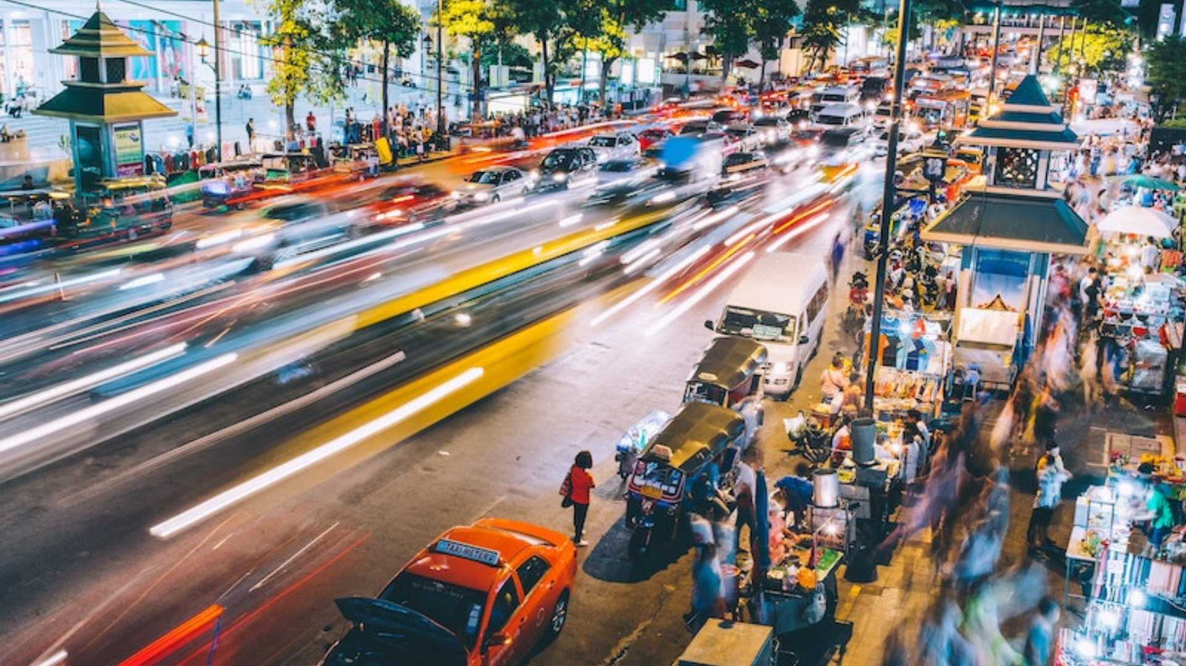
Problem Statement
Due to the continuous growth of autonomous vehicles, many countries started facing challenges related to environmental pollution, traffic congestion, not enough parking, accidents, as well as other inevitable Problems.
For example, a car with the ability to carry 5 people in full capacity, which is used to travel by and only for one person, 80% of the car capacity and fuel is wasted during individual travel.

Slide 3
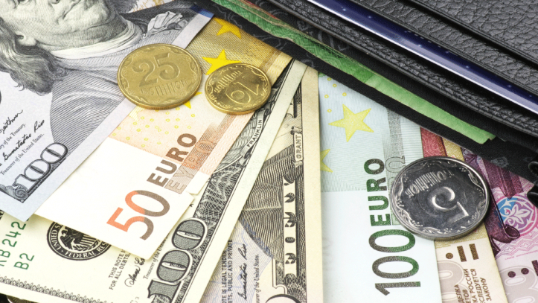
The major problems are cost and timing. If a person opts for public transportation, it takes a longer time to reach the destination, sometimes they have to walk a lot to go to the bus stop/railway station and switch the transportation medium in the route, likewise if they choose cab, the cost will go beyond a normal limit, moreover for the daily transportation, the cab option is not feasible for some people, such as students

Slide 4
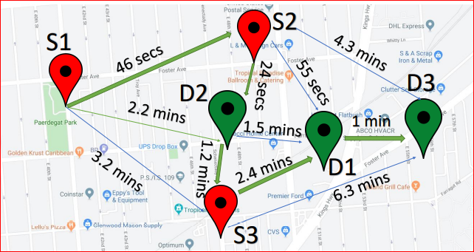
There is also a possibility that during ride sharing, the preferences of driver and rider doesn’t match, such as gender issue, music required or not and many more.
Sometimes, driver struggles to find the shortest and quick route. As the fuel prices increasing, cost of ride for a single person/driver could be more.
In ride sharing, it would be time consuming to add many details every time in app/website.
If the journey is too long, it would be boring or depressing for some people to travel alone. Many of us always try to find similar faces during our day to get a normal smile on our faces.

Slide 5
Proposed Solution
The best solution to overcome from all these problems is
‘Smart Ride, Car Sharing’

Slide 6
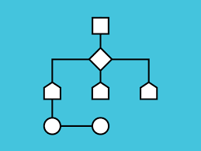
In ride sharing, people who are going to their college/office and have almost similar timeslot and same route such that they can share a car, which is owned by a driver, in short, we share empty vehicle seats with people (known or unknown but verified).
There are few AI algorithms that we can use to find the shortest route and best path to travel. The driver shares their own car with people, who have the same or on the way source and destination.

Slide 7
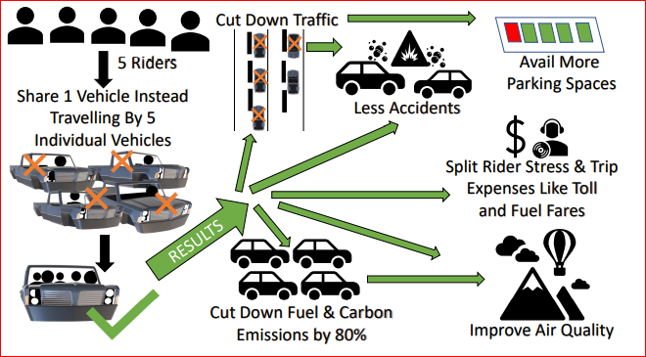
By smart sharing, we can reduce the traffic, pollution, less time to travel and most importantly cost effective for both driver/owner and rider.
Smart ride would be beneficial for both driver and rider as they both get paid. The driver can utilize that money in fuel and the rider can travel with less amount of money in a short interval. We can build app/website so that people can navigate through it. By Ride sharing, person can find travel partners to share their journey, which could be joyful and supportive.

Slide 8
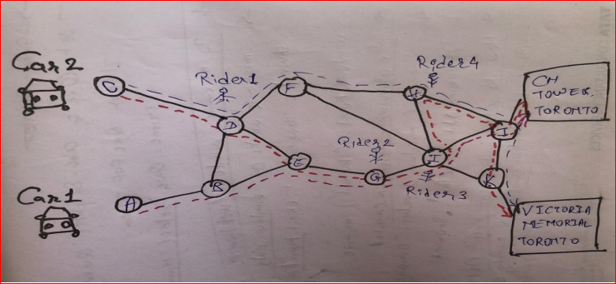
Machine learning
The search for a suitable Machine Learning classifier first led us to KNN and SVM as we were trying to classify the drivers according to the customer attributes but soon we understood the scope of the problem and the limitations of our approach

Slide 9
K Means Clustering:
After struggling to accommodate our data with classifiers we understood that we needed a new approach for our model. Having a good look at our dataset we realized that it would be more suited to a clustering model.
We finalized on K means clustering as ou final model, as it allowed us to easily cluster our users according to their attributes and match them with other people accordingly

Slide 10
Our User attributes that will be used for the Clustering
K-means clustering is a type of unsupervised learning, which is used when you have unlabeled data (i.e., data without defined categories or groups). The goal of this algorithm is to find groups in the data, with the number of groups represented by the variable K.
This was perfect for our uncategorized data.

Slide 11
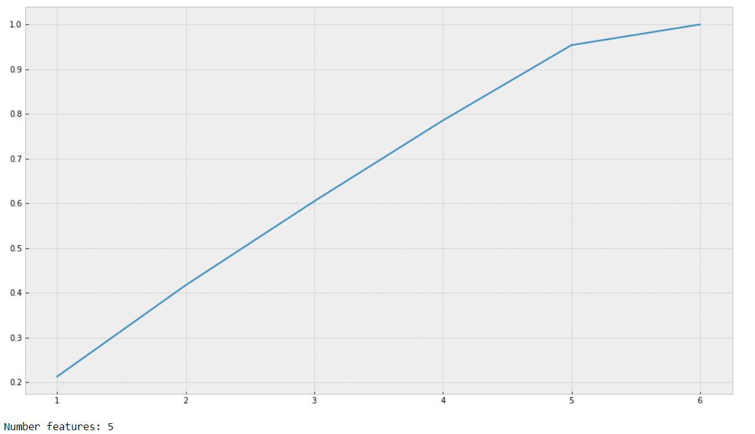
PCA variance and Number of Principal components until overfitting:

Slide 12
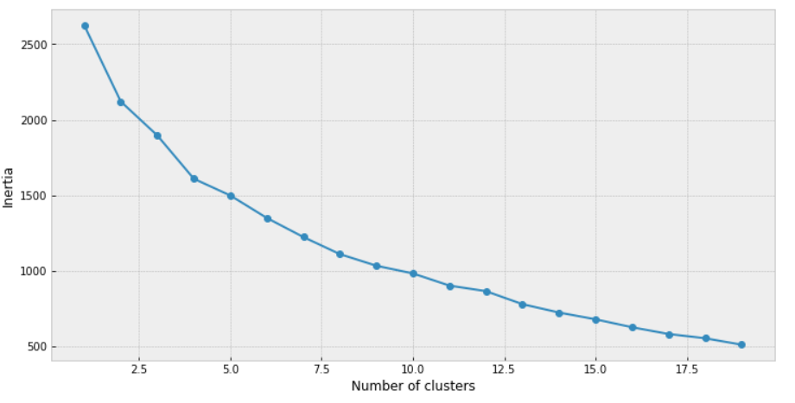
Elbow Chart for our model:

Slide 13
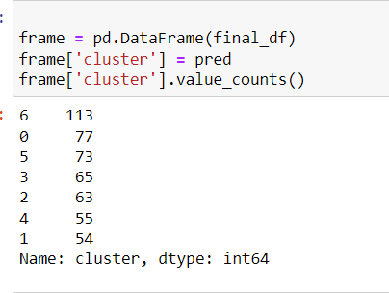
Final user clusters based on their attributes:
Now whenever a new user will be pushed through the model, it will be sent to one of the 7 clusters and then matched with the drivers from within that cluster

Slide 14

Utilized Data, Tools, Technology, and Techniques
We have invented and developed “Smart Ride” software with the Django framework using Google Maps API in PyCharm.
Django Framework
Django is a Python-based free and open-source web framework, which follows the model-template-view architectural pattern.
Google APIs added
Directions API - It is used to display route between two points. Route similarity is inferred based on this to broadcast ride request to specific drivers.
Distance Matrix API - It is used to get distance between two points. This is used to decide fare of ride.
Geocoding API - It is used to convert a place name(For e.g.: Central Park, New York) to its corresponding coordinates(latitude and longitude).
Maps JavaScript API - The API is used to make calls to different APIs using JavaScript.
Places API - The API is used to get suggestions of places when user types a string.

Slide 15
Bootstrap
Bootstrap is a free and open-source CSS framework directed at responsive, mobile-first front-end web development. It contains CSS- and JavaScript-based design templates for typography, forms, buttons, navigation, and other interface components.
Jira
We have used Jira for Project Management. Initially we created a road map and divided the task in stories and assigned each stories to every team member for tracking purpose. Added the screenshots and comments also, wherever required.
IBM Watson Assistance
IBM Watson Assistant is an Artificial Intelligence service in IBM Cloud that lets us build, train and deploy Chabot over the cloud. It is cost effective and smarter solution for small and large enterprises.

Slide 16
Python Google Maps API
The API is used to make calls to different APIs using Python.
There are two types of users:
Driver - A user who wants to share the ride with other people along the same route or is a driver.
Rider - A user(other than driver) sharing a ride. A user can book a ride and share a ride with driver.
Database
SQLite is an open-source database that helps to interact with relational databases. SQLite is stored as a single file. This makes sharing databases easier. By default, Django uses the SQLite database.

Slide 17
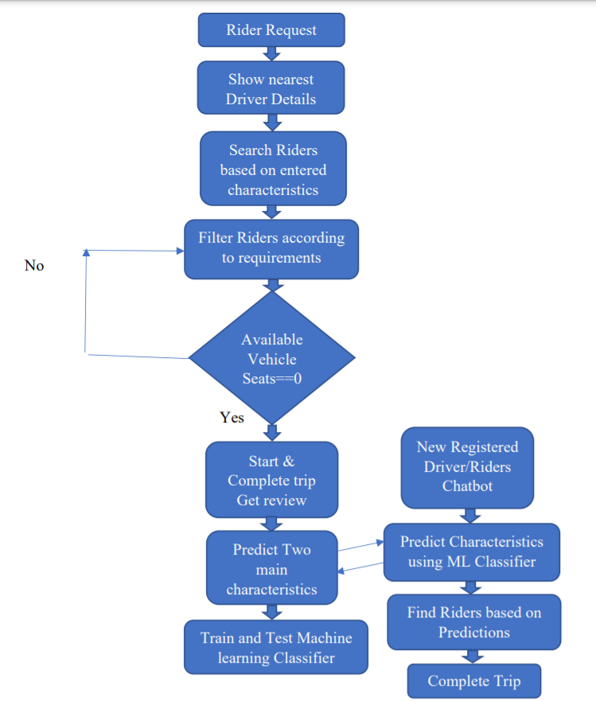
Flow Diagram

Slide 18



Progress
The progress up until now has been the focused on the creation of the platform on which the service will run, i.e, the website, and the rider driver matching model, which is a machine learning component of this project
The front end of the website is almost complete and a prototype version of the rider-driver matching model has been created which will be later integrated into the site.
The process of tuning the model, adding/deducting features from the training dataset and getting the model performance up to a satisfactory level will take some time

Slide 19
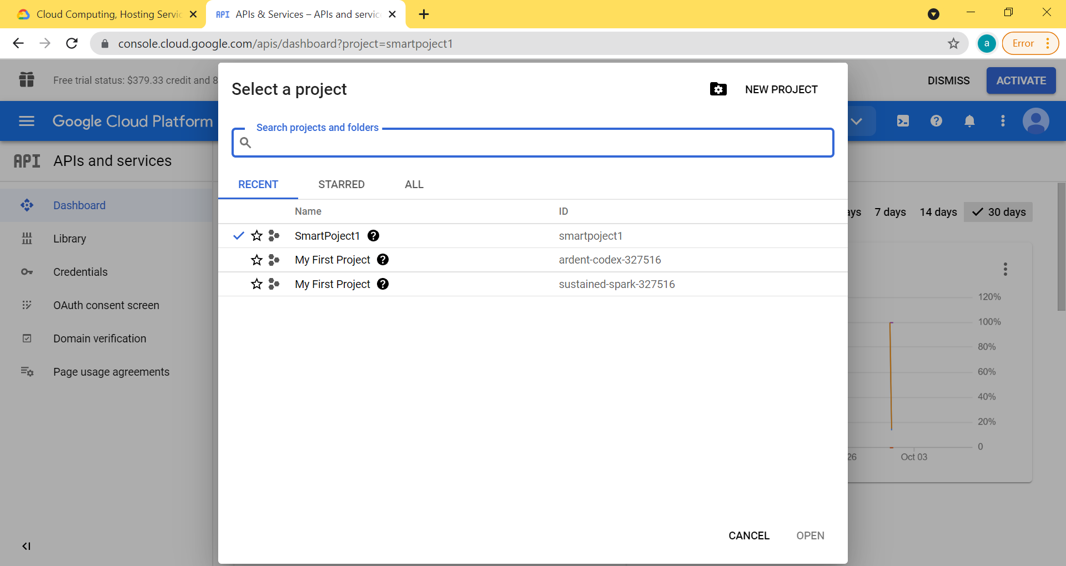
Google Cloud Platform: SmartProject1

Slide 20
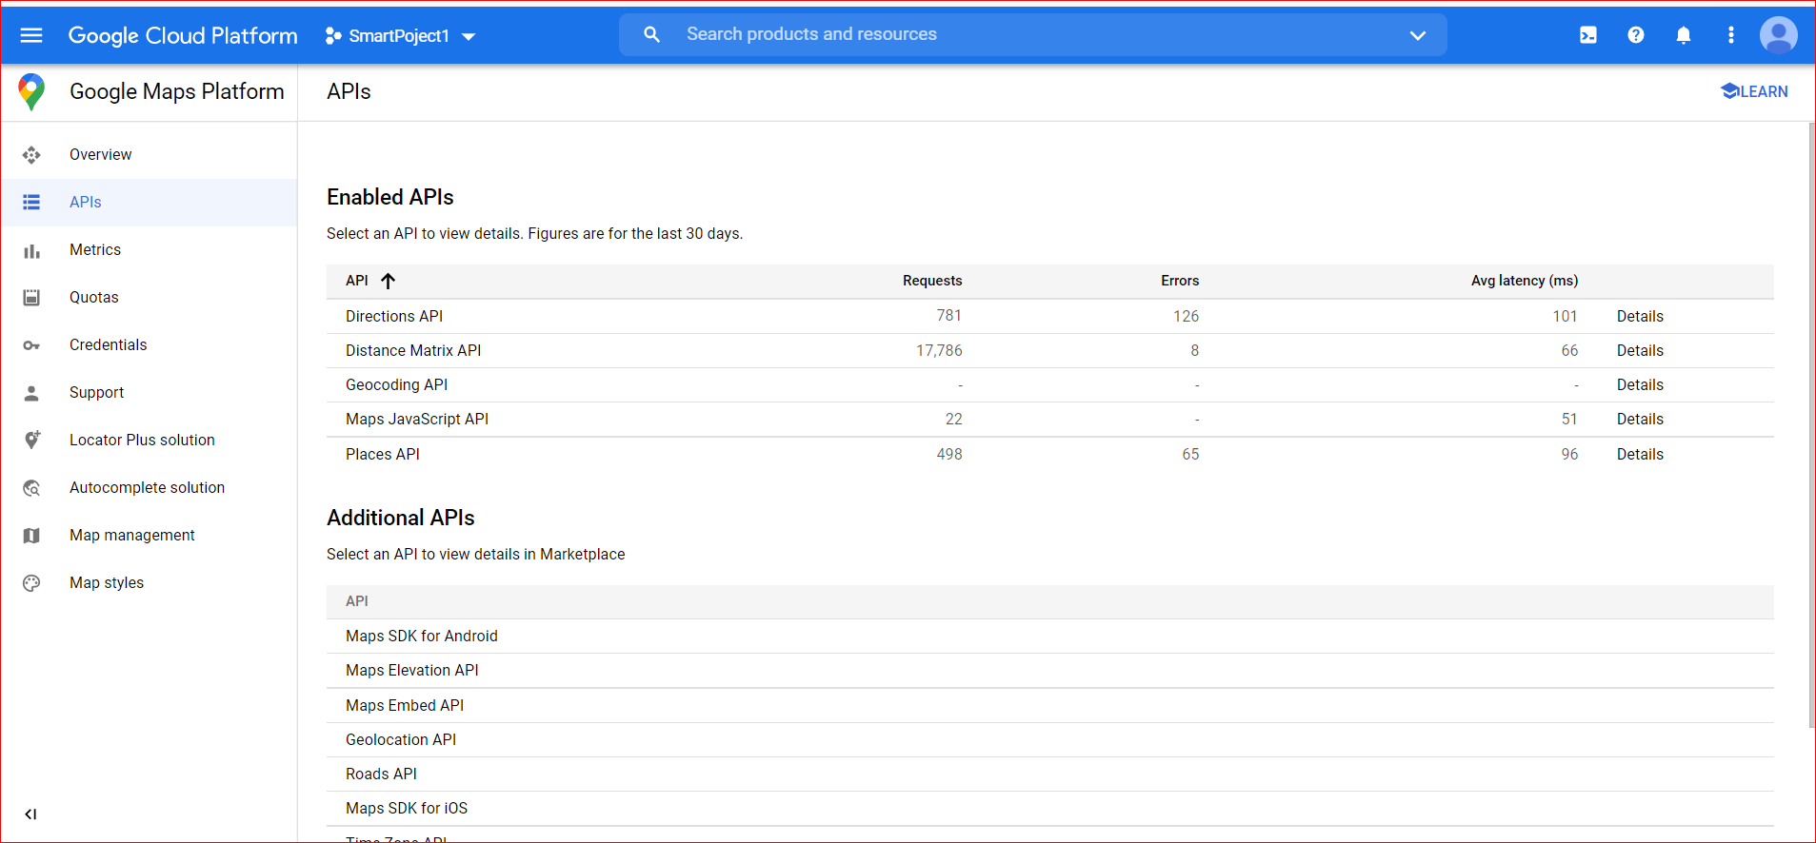
Google Cloud Platform Dashboard

Slide 21
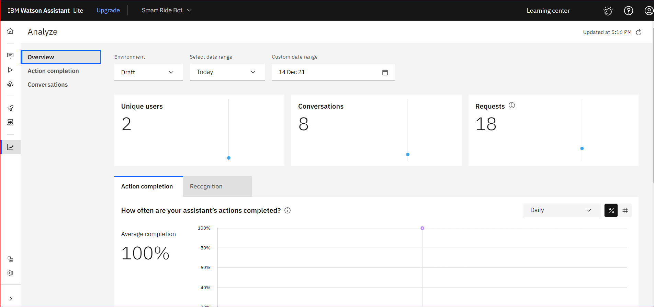
IBM Watson Assistance

Slide 22
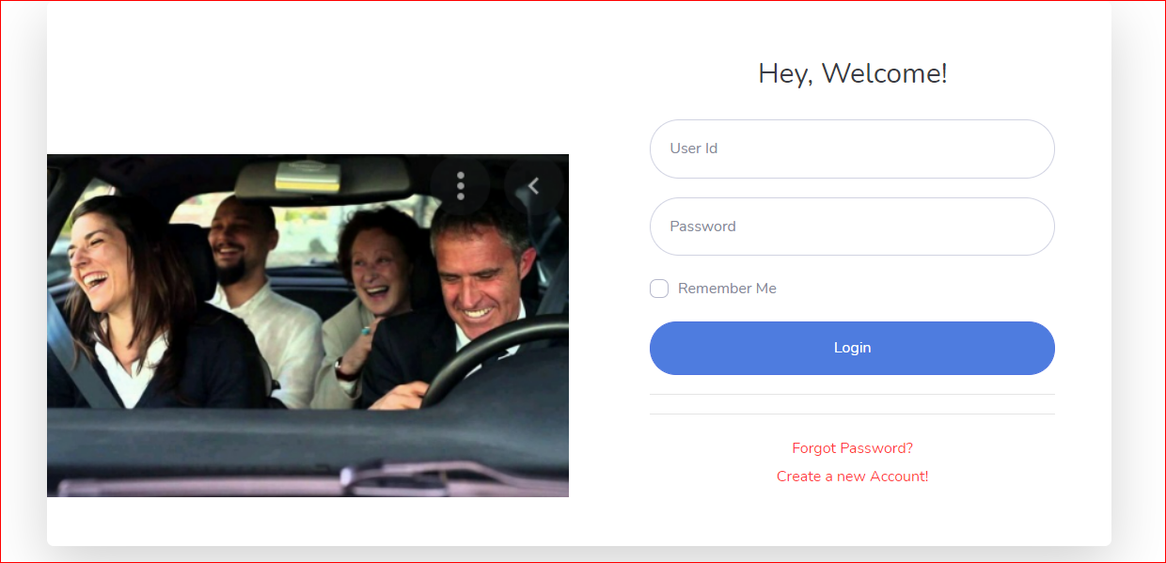
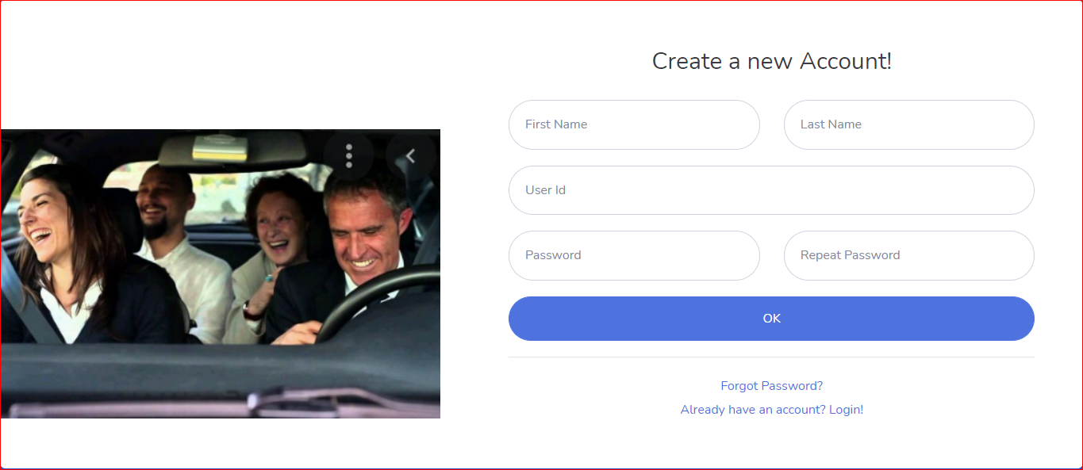
LOGIN SCREEN
CREATE NEW ACCOUNT

Slide 23
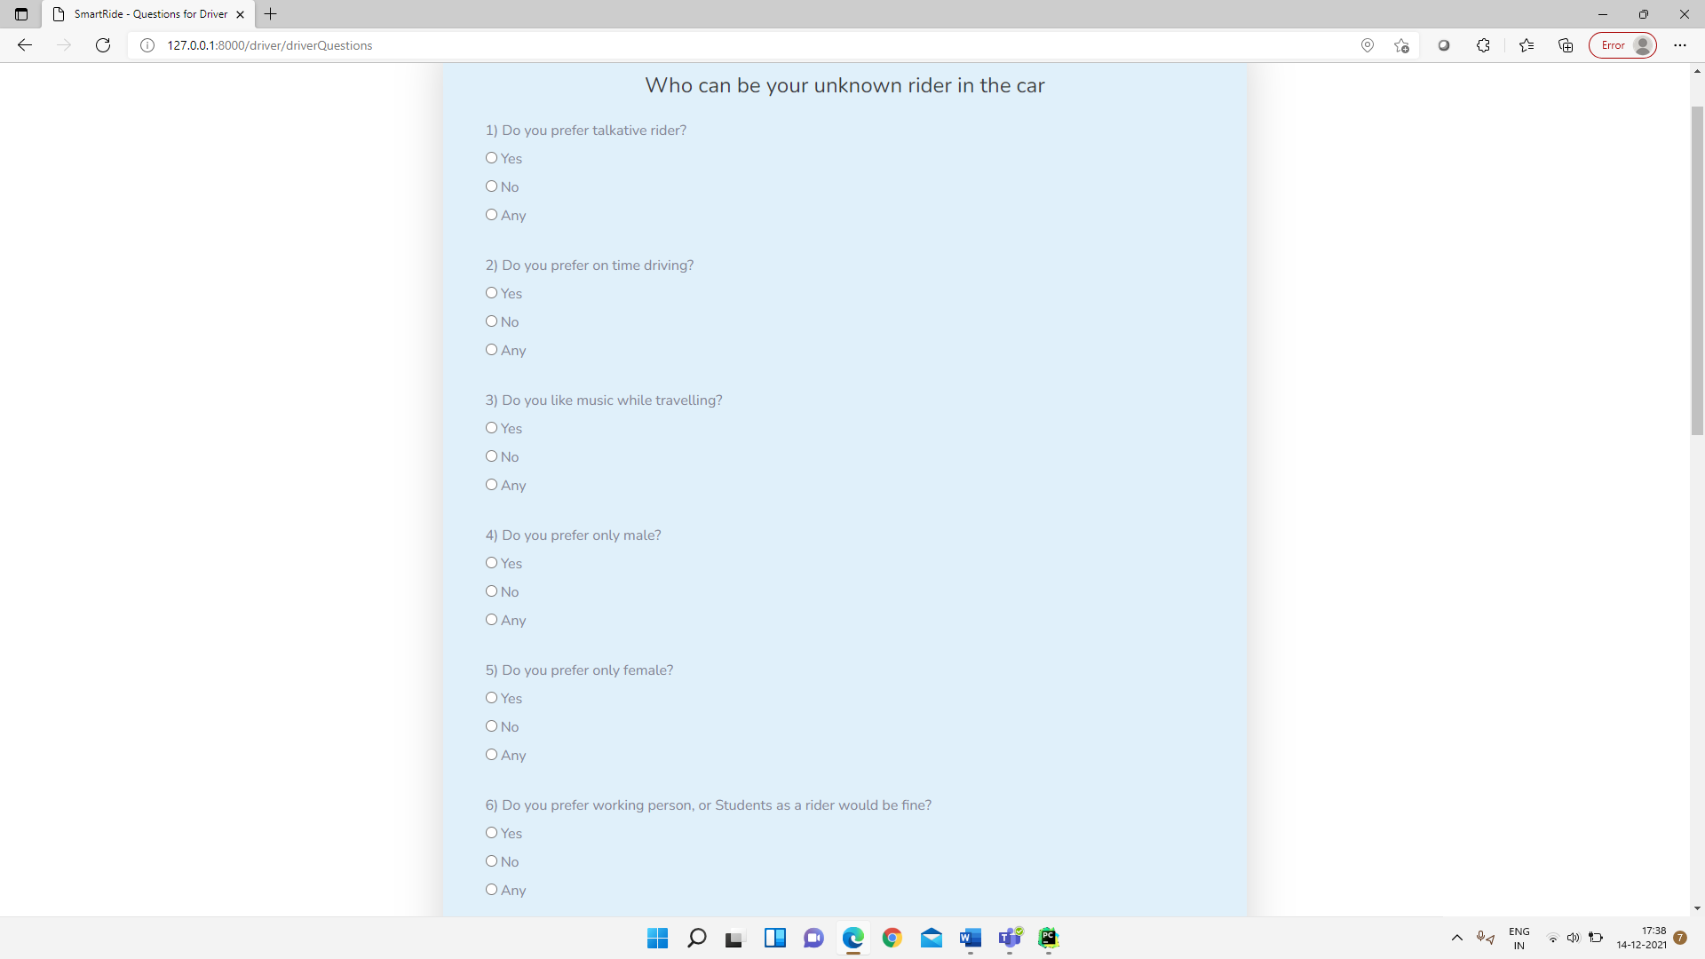
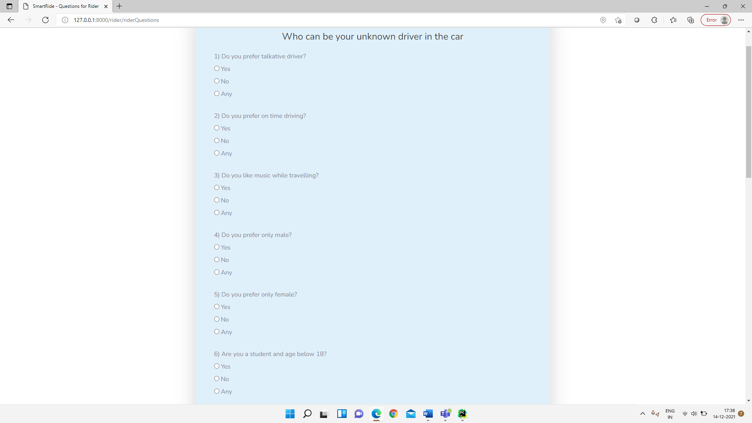
SELECT OPTIONS RIDER DRIVER

Slide 24
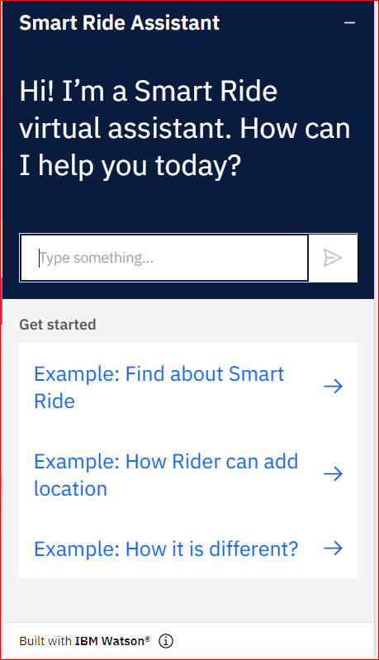
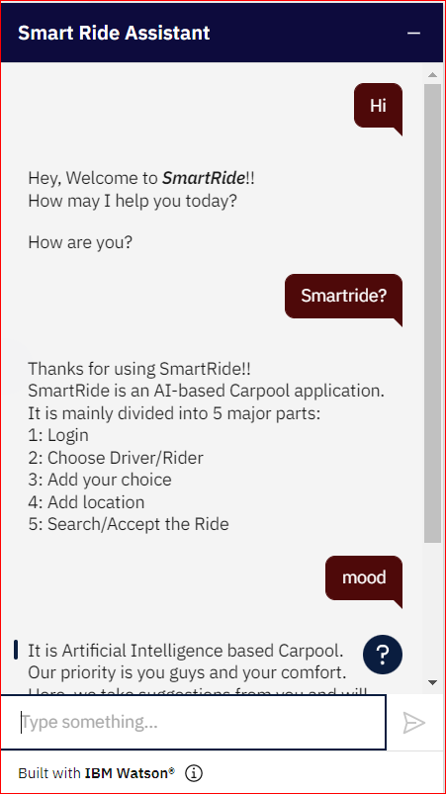
ChatBot

Slide 25

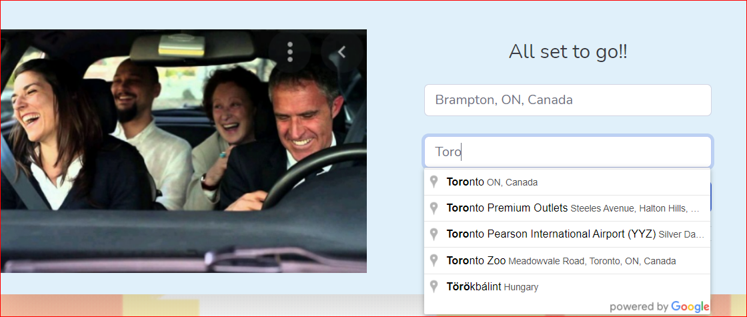
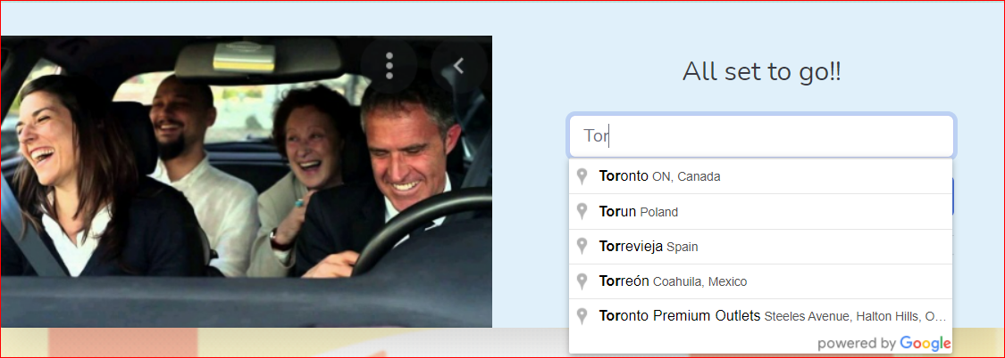
SELECT OPINION RIDER DRIVER
Here the Rider/Driver is auto suggested places using the Google Places API

Slide 26
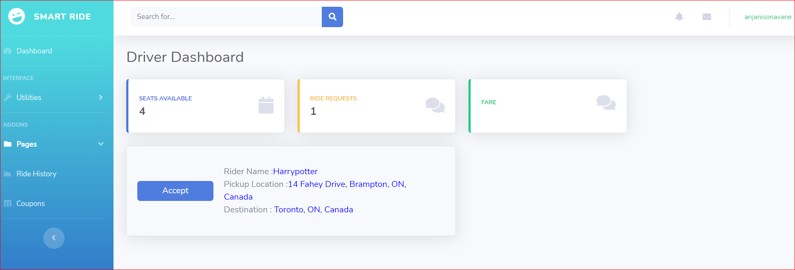
DRIVER DASHBOARD

Slide 27
Conclusions
To conclude our Presentation, we would like to bring your attention to what the product will look like. By the final term, it will have:
A machine learning model that pairs riders and drivers by taking their preferences into account.
User's ability to register with us and look for carpools
Google maps API will help the platform in gauging the proper distances and provide live traffic volume data.

Slide 28
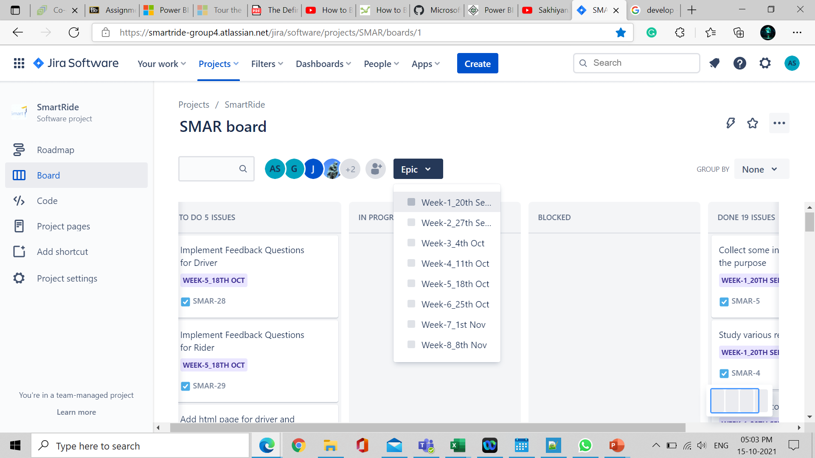
Jira timeline
SMAR board - Agile board - Jira (atlassian.net)

Slide 29
References
[1] Ferguson, E. (1997) The Rise and Fall of the American Carpool: 1970-1990. Transportation, 24, 349-376. https://doi.org/10.1023/A:1004928012320
[2] ONU-Hábitat and ONU-Hábitad (2015) Reporte Nacional de Movilidad Urbana en México 2014-2015. Rep. Glob. en Asentam. Humanos, p. 100
[3] Ferguson, E. (1990) Demographics of Carpooling. Transportation Research Record, 1496, 142-150
[4] Minett, P. and Pearce, J. (2011) Estimating the Energy Consumption Impact of Casual Carpooling. Energies, 4, 126-139. https://doi.org/10.3390/en401012

Slide 30

QUESTIONS?

